Slide 1

Customer Booking
Customer Booking Prediction and Visualization

Slide 2
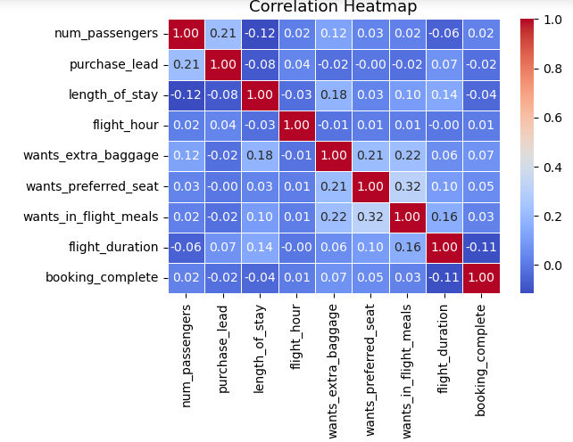
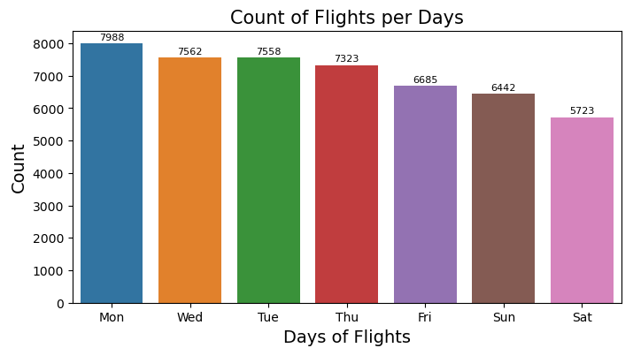
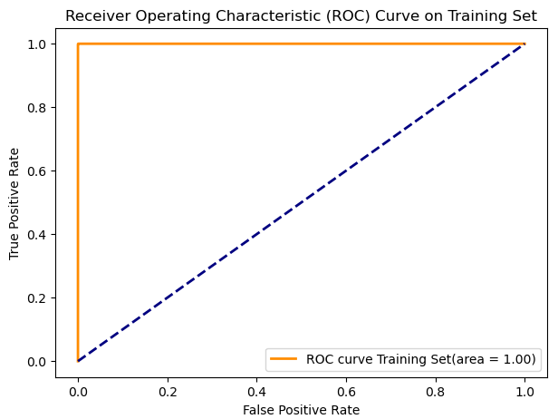
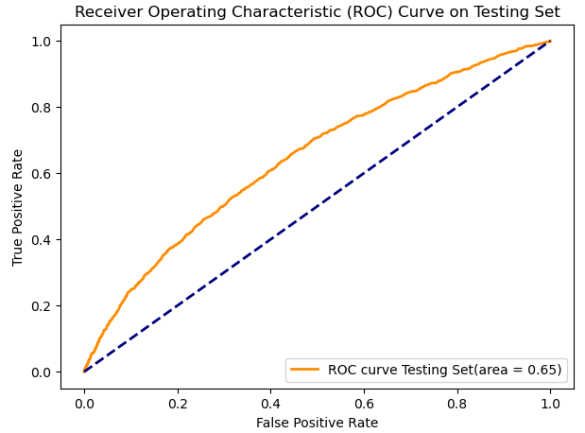
Prediction and ROC Result
ACCURACY SCORE OF TRAINING SET : 100%
ACCURACY SCORE OF TESTING SET : 84%
ROC Accuracy of Training Set is : 100%
ROC Accuracy of Testing Set is : 64%

